Slide 1
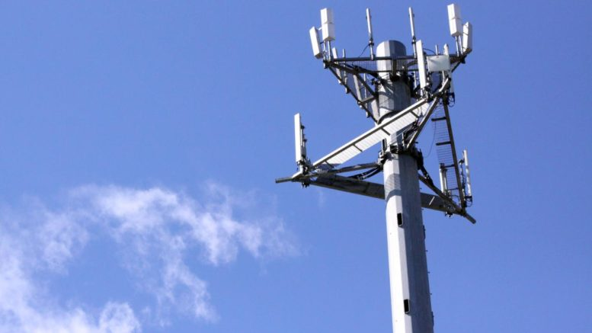
RF Optimization Tool
Mobile Networks

Slide 2


RF Optimization in Telecommunications
In the Mobile Telecommunications world, there's a particular area called Radio Frequency Optimization, which has the purpose to enhance the voice and data calls at a radio frequency level, leading to an end-user satisfaction feeling in regards to:
Voice/Data calls completion success.
Enough throughput in RF Channels to allow fast navigation in data calls.
Enough coverage to allow users perform good quality voice and data calls.

Slide 3
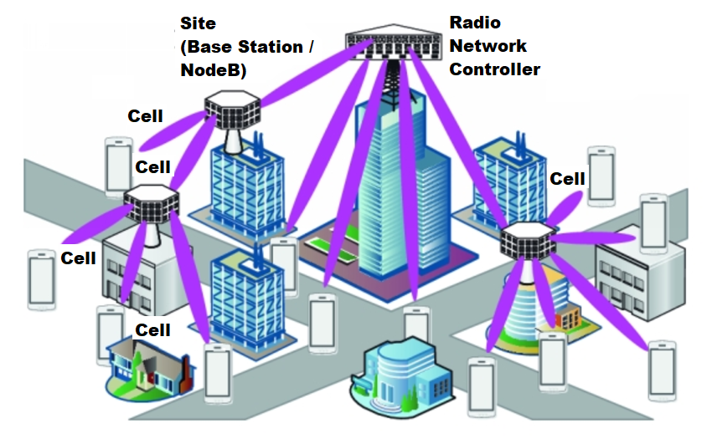
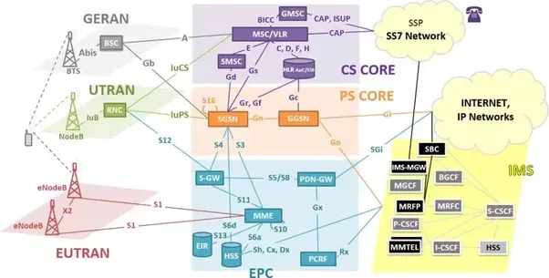
Radio Access Network
Radio Access Network
Mobile Network Architecture
RAN

Slide 4

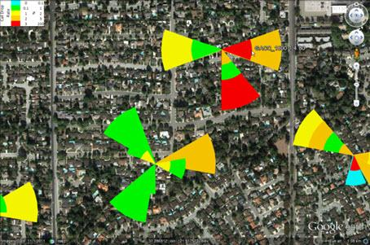
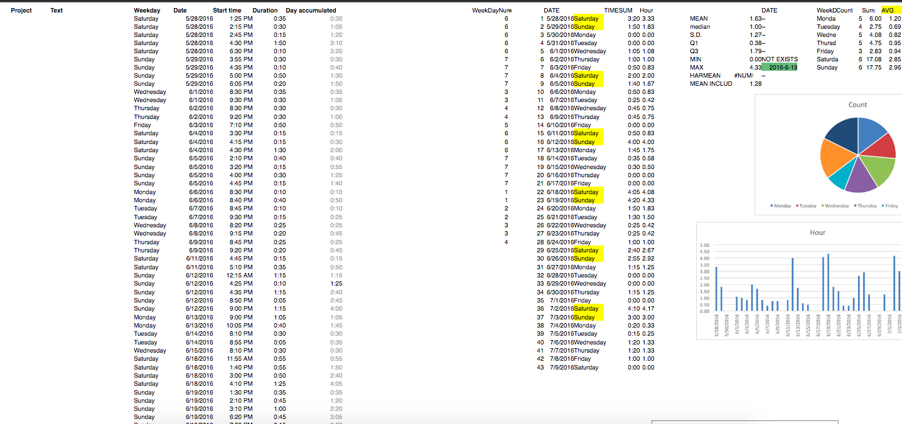

Current Problematic in RF Opt Tasks
EMS / NMS
Manual Tasks!
Tables, Formulas, KPI Results and Graphs
Google Earth, upload Templates

Slide 5
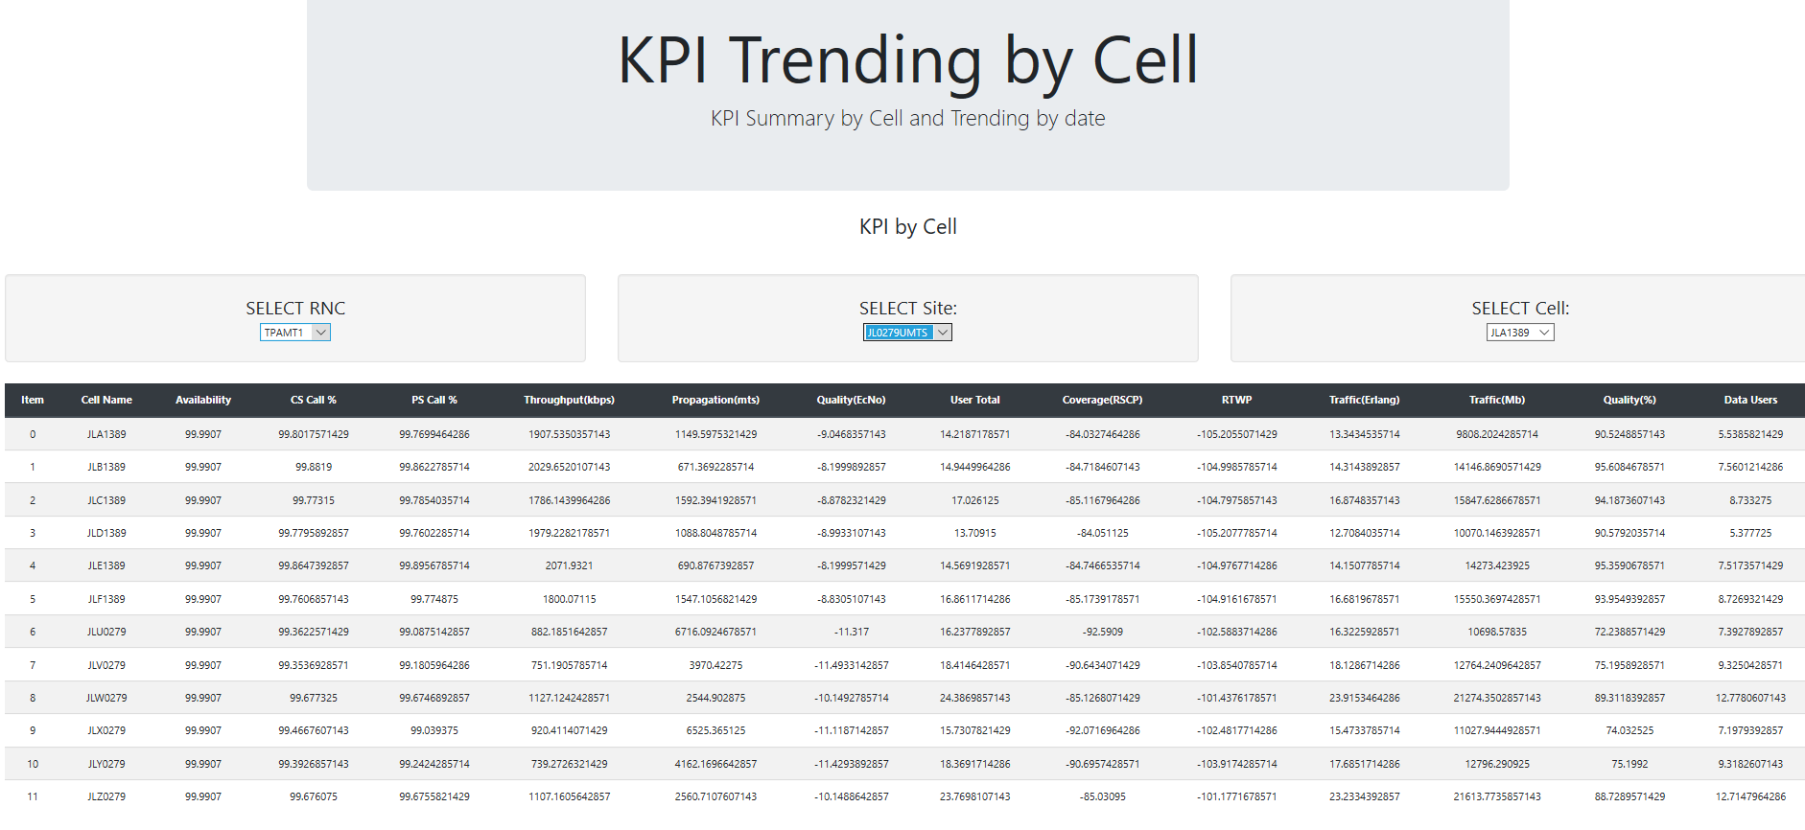
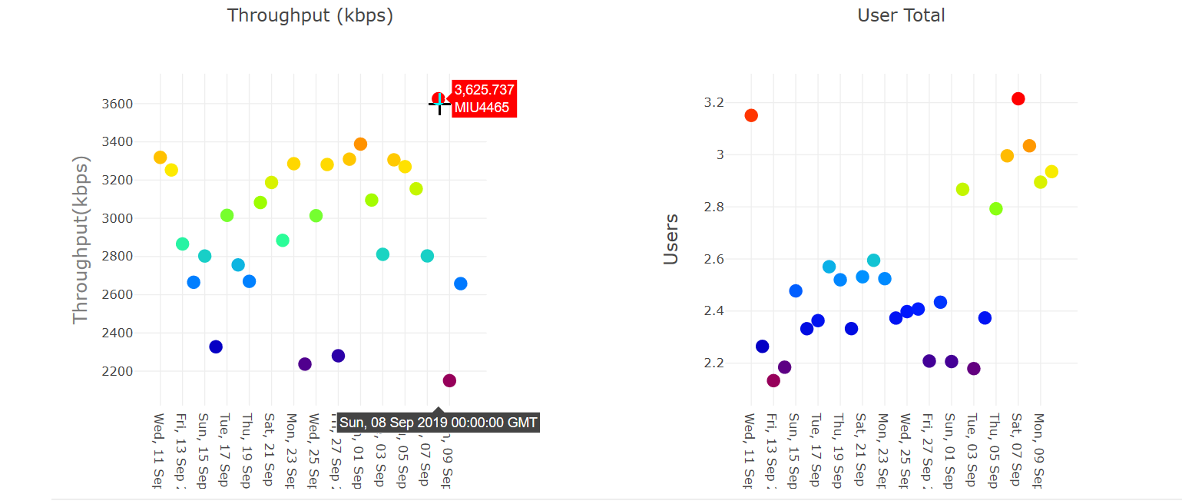
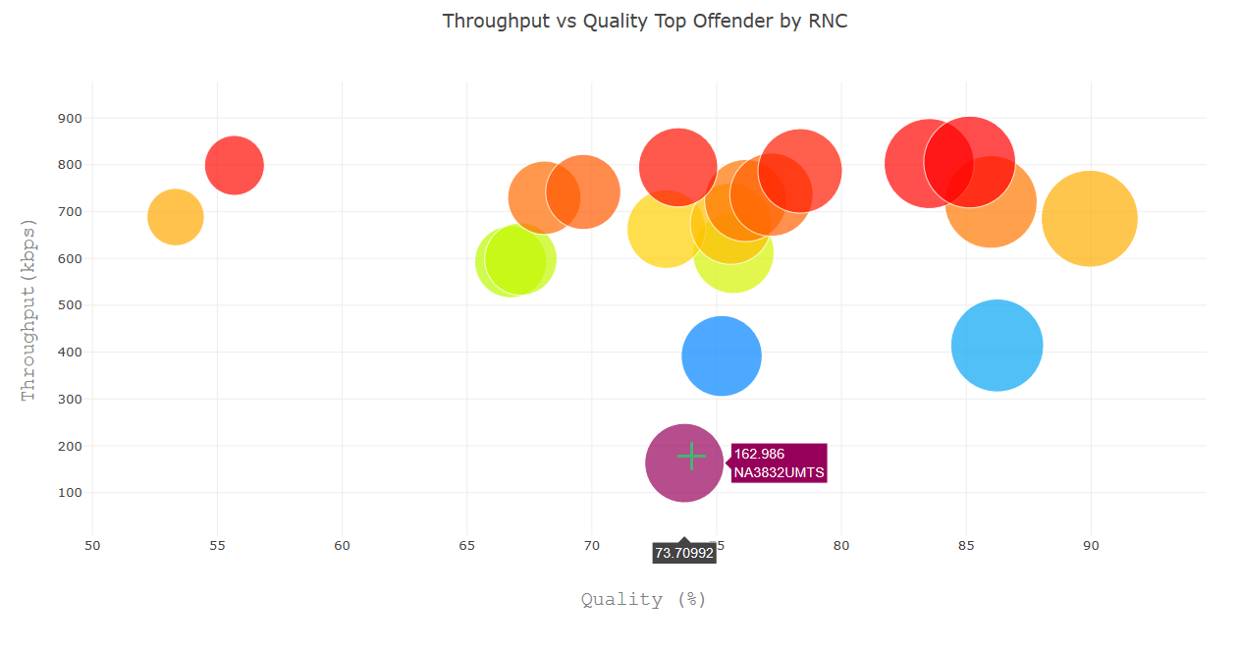
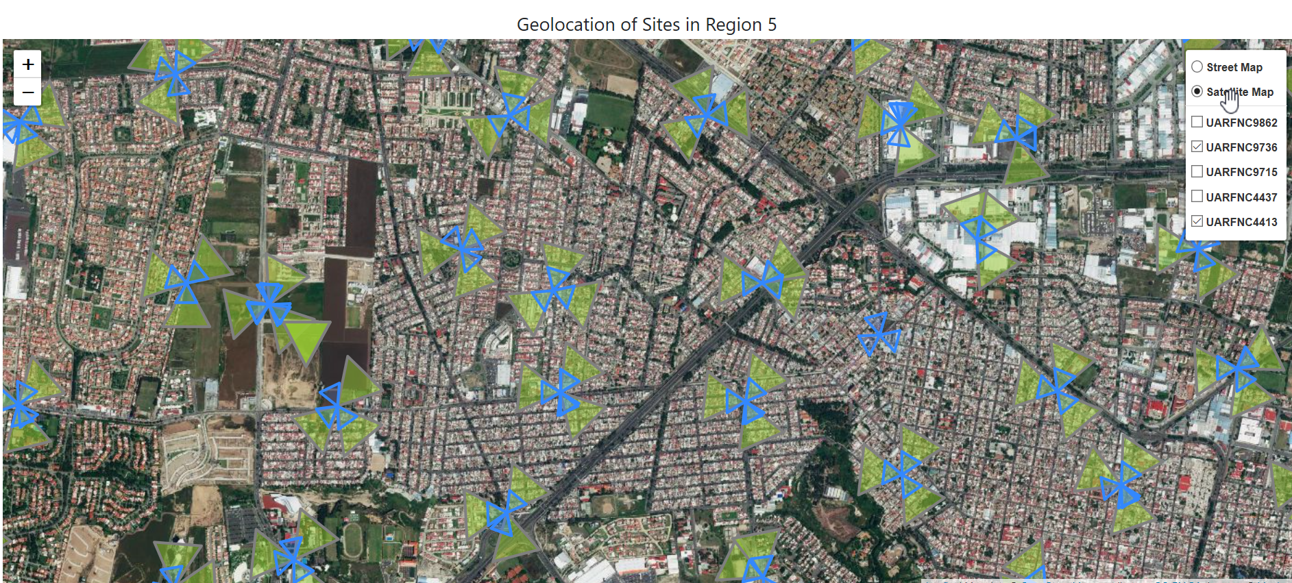
RF Optimization Tool - Demo
Information Analyzed:
Mexico - Region 5
1 month of data
10 RNCs, 2800 Sites (approx.), 31000 Cells (approx.)
Tool:
PostgreSQL
JavaScript, Python, HTML
New Library in JS: Maths
To plot sites in map as a polygon using Sin and Cos.

